Slide 1
Covid and the Stock Market
Group Members:
Danish Mohammed
Joshua Perez
Ria Datla
William Hodges

Slide 2
Executive Summary

Slide 3
Project Overview and Goals
Goal 1: Identify which countries covid case reports and stock indices to use in our analysis
Valuable exploratory analysis of the covid cases, prevalence, and stock market performance over the same timeframe to provide insights to the average consumer and public health masses
Goal 2: Identify correlations and trends between COVID-19 data and stock indices

Slide 4
Key Research Questions
What is the structure of the covid dataset and what patterns can we identify?
What is the structure of the indices dataset and what patterns can we identify?
What are the countries in the dataset with the most covid cases?
What is the relationship between Covid cases in the listed countries and the stock market performance for a major index in that country?

Slide 5
Goals and Approach
Data gathering, cleaning and understanding the data
Identify top 5 countries' with reported Covid cases
Explore the correlation between the total amount of cases and stock market performance for the 5 elected countries as well as prevalence and stock market performance
Data Visualization and presentation of our findings

Slide 6
Key Findings
The top 5 countries with reported covid cases were: USA, China, India, France, and Germany
The indices dataset contained data for the S&P 500 (USA), SSE Composite Index (China), BSE Sensex Index (India), CAC 40 (France), and the DAX Index (Germany)
There is positive correlation between total covid cases and stock market index prices across the top 5 countries between 2019 and 2024

Slide 7
Next Steps
Refine analysis with additional data points and more granular regional data as well as addition measures of stock market performance
Recommendations for further research into sector-specific impacts and long-term economic recovery

Slide 8
Data Collection

Slide 9
Sources of Data
Kaggle Data on COVID-19 (coronavirus) by Our World in Data
Country-wise Data: Information on COVID-19 cases, deaths, recoveries, testing rates, and other relevant metrics for different countries.
Time Series Data: Daily updates or periodic snapshots of COVID-19 statistics, allowing for trend analysis over time
Kaggle World-Wide Stock Market Indices Data (1997 - 2022)
Index Information: Names and symbols of stock market indices.
Time Series Data: Historical data on index values, including opening price, closing price, high and low prices, volume traded, and percentage changes.

Slide 10
Data Cleaning Process
Conducted rigorous data cleaning to handle missing values, outliers, and inconsistencies in both COVID-19 and stock market datasets.
Standardized date formats and ensured data integrity across datasets.

Slide 11

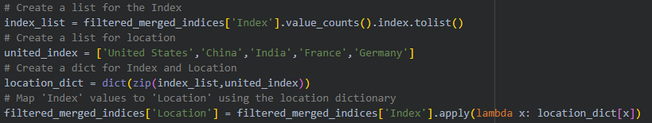
How did we code?
Analysed the Covid and Stock Index Dataframes
Combined Dataframes
Made Graphs and Statistical analysis.

Slide 12
Data Exploration - Covid Dataset

Slide 13
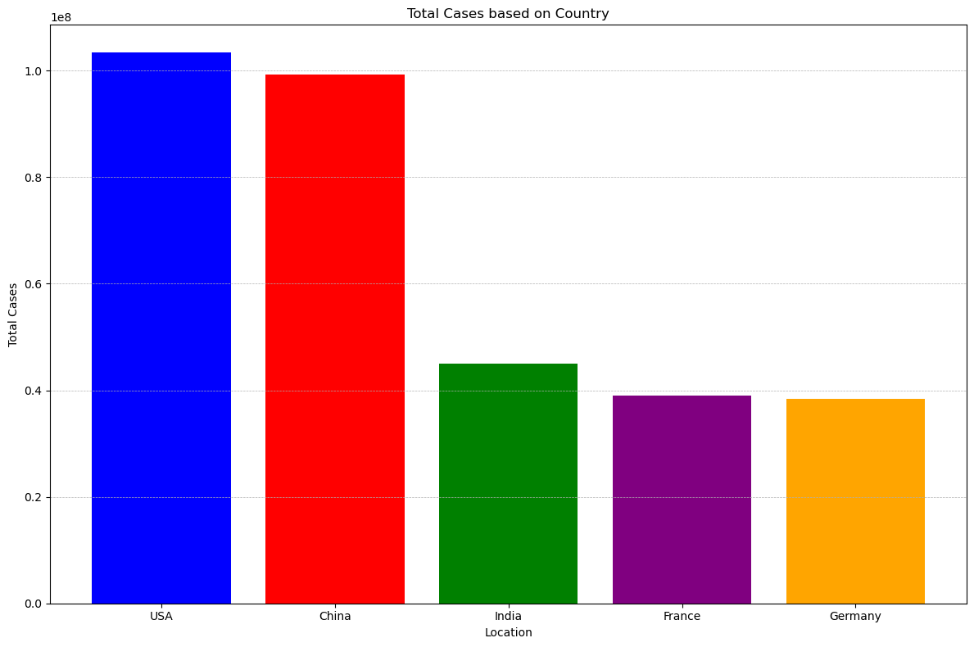






Slide 14
Prevalence =
(Total number with disease) / (Population at risk for the disease)

Slide 15
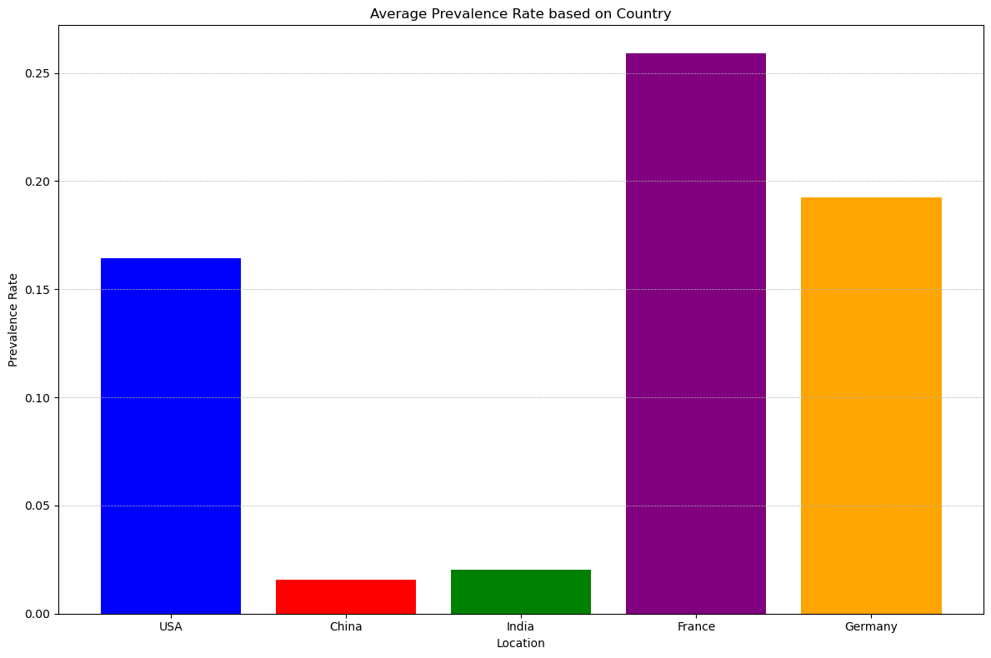

Slide 16
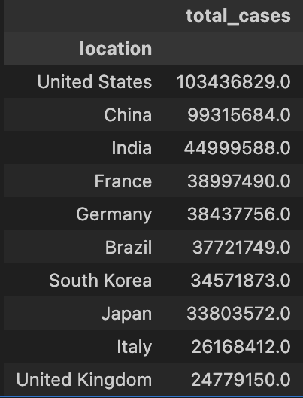
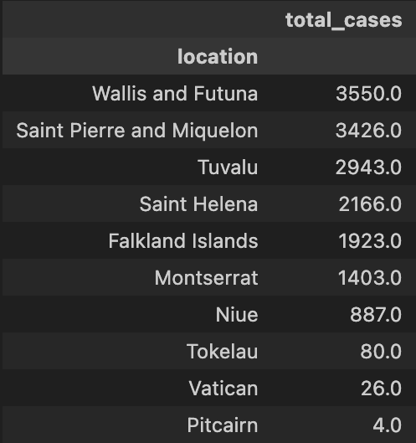
Highest Cases
Lowest Cases

Slide 17
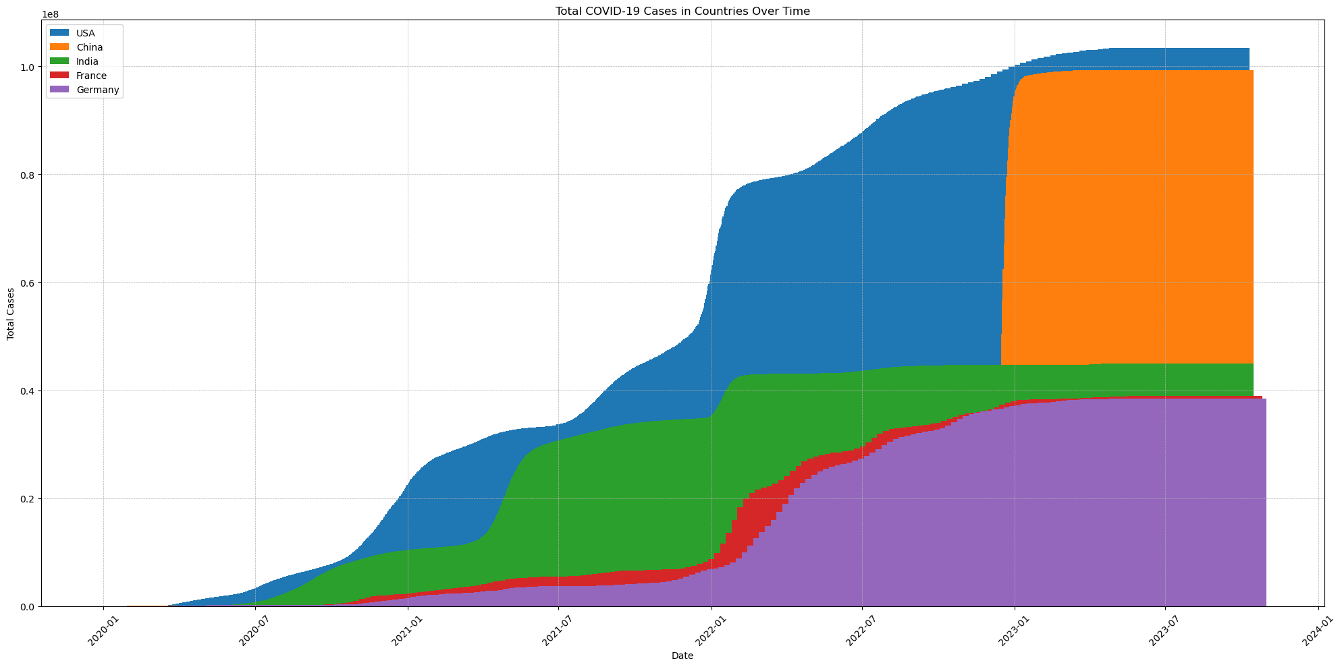

Slide 18
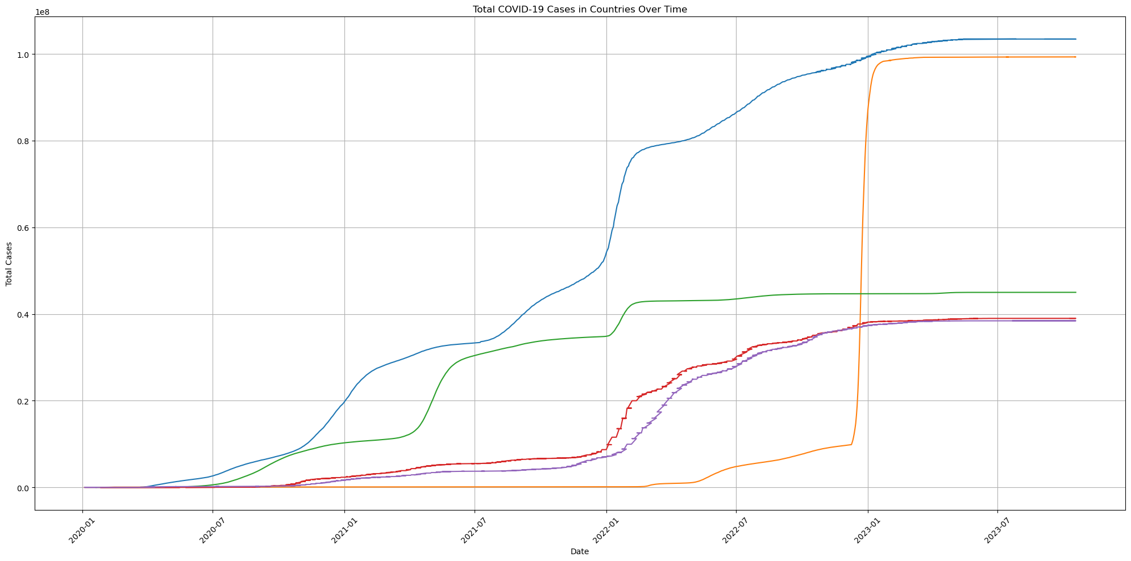

Slide 19
Data Exploration - Stock Indices

Slide 20
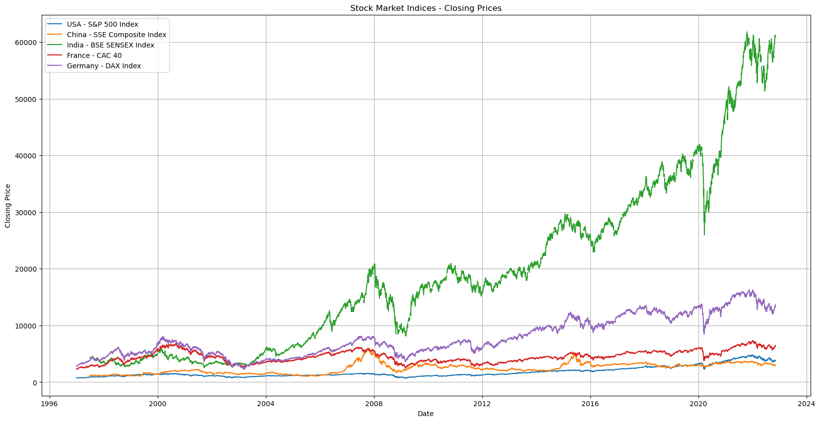

Slide 21
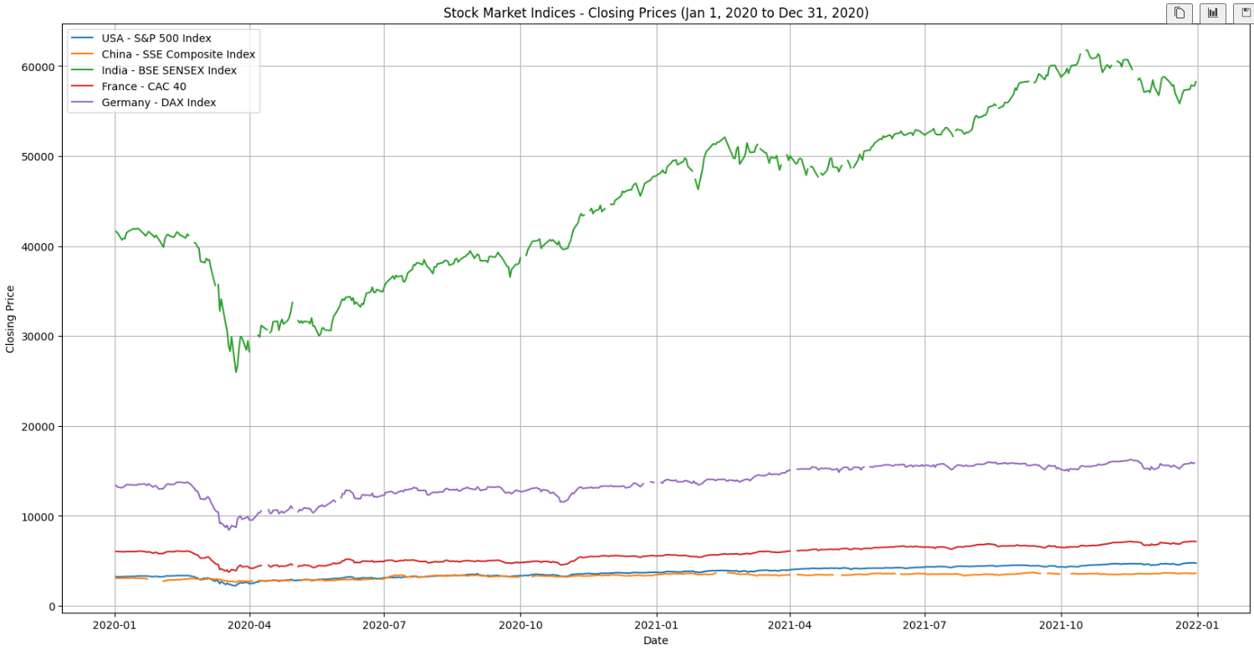

Slide 22
Data Analysis and Conclusion

Slide 23
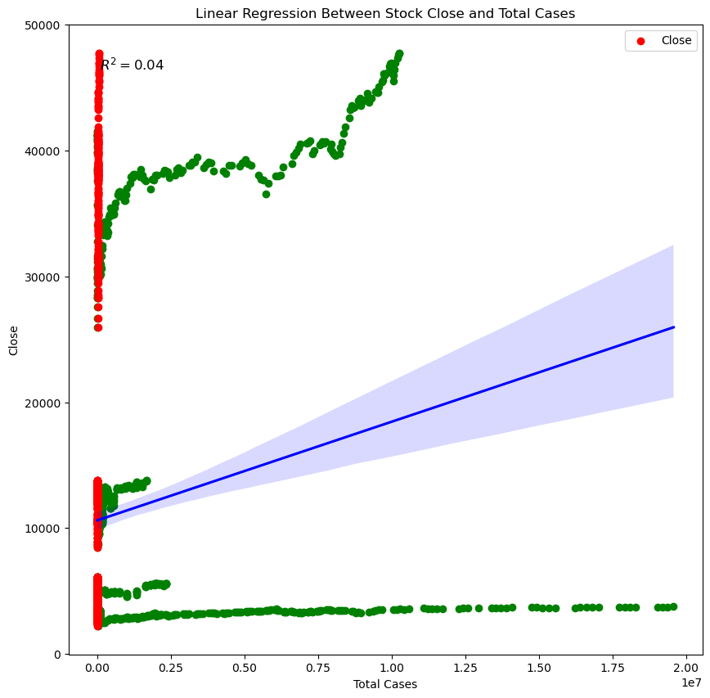

Slide 24
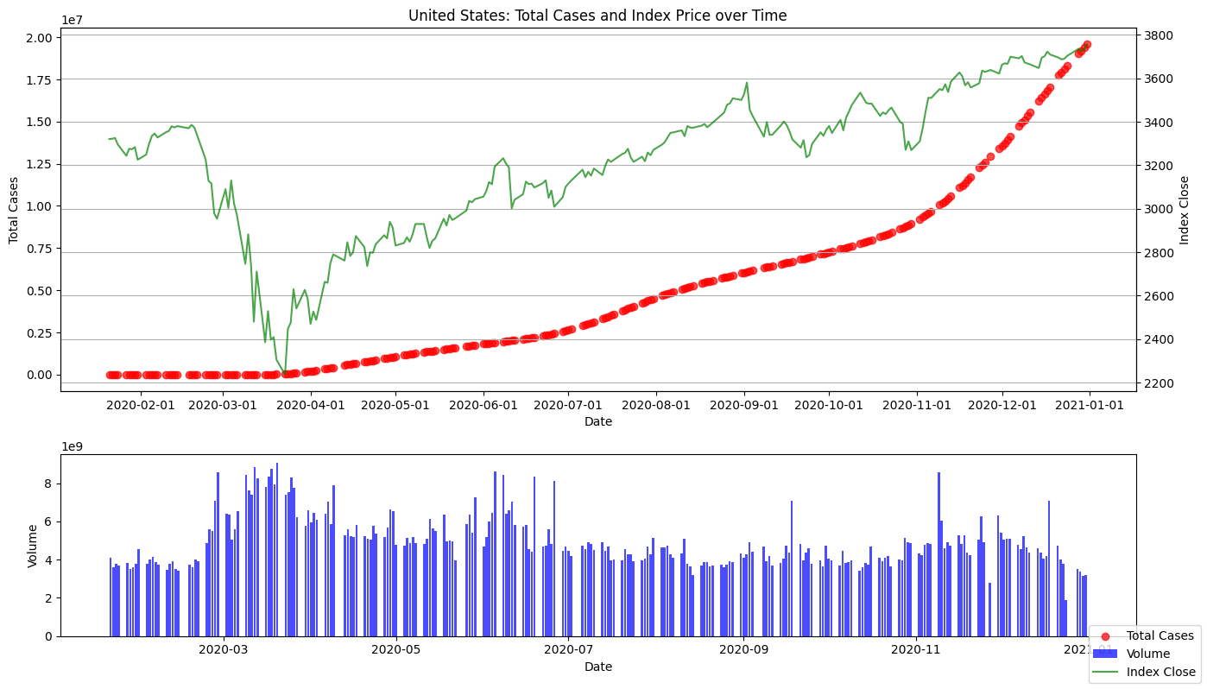
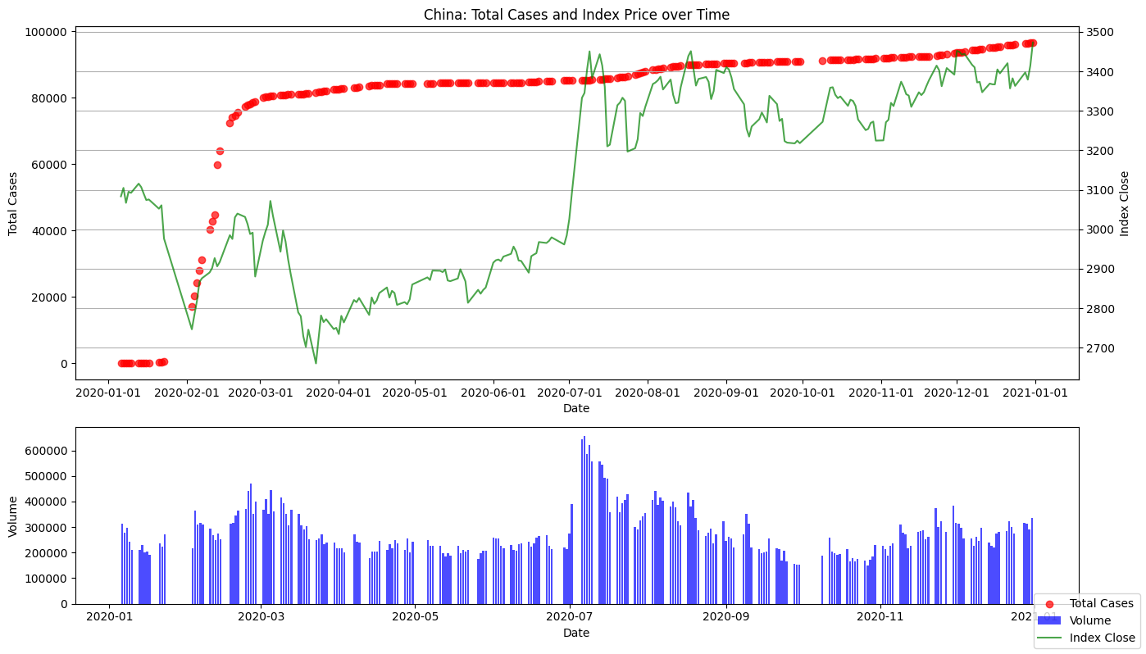
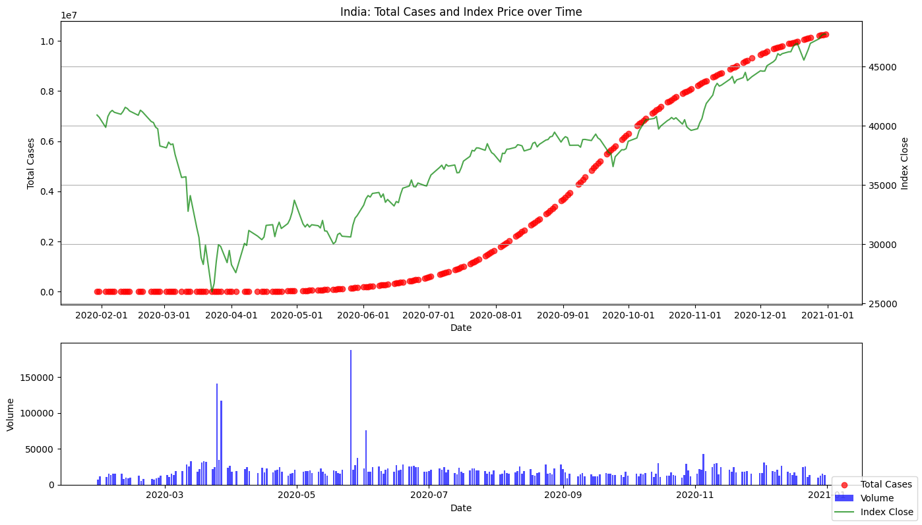
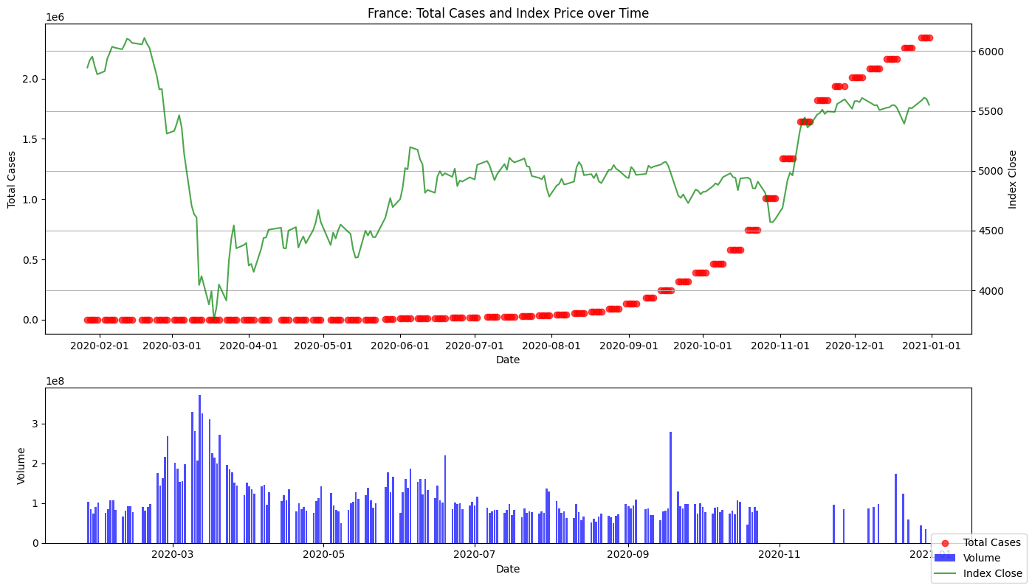
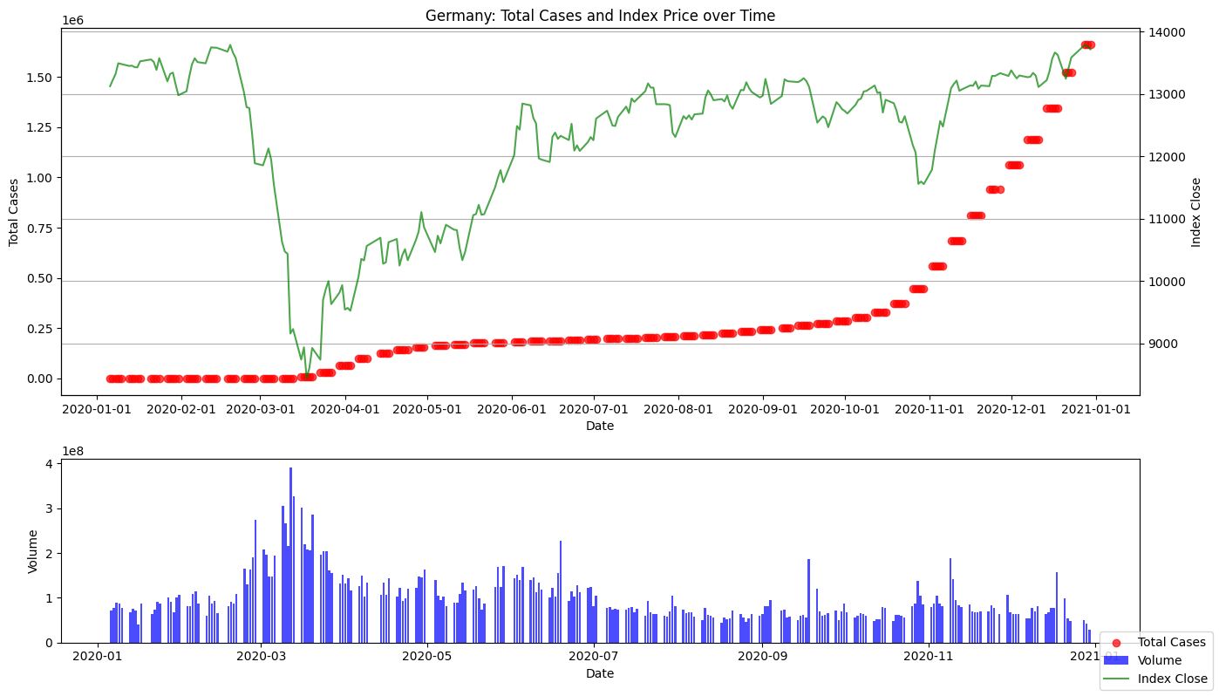
Notes:
United States Correlation of Total Cases to Index Close = 0.7742912518186532
There is a strong positive correlation (close to +1) between the total number of COVID-19 cases in the United States and the closing values of the stock market indices. This suggests that as the number of COVID-19 cases increases, the stock market indices tend to also increase.
China Correlation of Total Cases to Index Close = 0.31772805910239976
There is a moderate positive correlation (closer to 0.3) between the total number of COVID-19 cases in China and the closing values of the stock market indices. The relationship is weaker compared to the United States but still indicates some tendency for the indices to move in the same direction as COVID-19 cases.
India Correlation of Total Cases to Index Close = 0.7857324316538402
There is a strong positive correlation (close to +0.8) between the total number of COVID-19 cases in India and the closing values of the stock market indices. Similar to the United States, this suggests that COVID-19 case numbers and stock market performance in India tend to move together.
France Correlation of Total Cases to Index Close = 0.4015611064589938
There is a moderate positive correlation (around 0.4) between the total number of COVID-19 cases in France and the closing values of the stock market indices. The relationship is weaker compared to the United States and India but still indicates some level of association.
Germany Correlation of Total Cases to Index Close = 0.36183544586894134
There is a moderate positive correlation (around 0.36) between the total number of COVID-19 cases in Germany and the closing values of the stock market indices. Similar to France, the relationship suggests a weaker but noticeable tendency for the indices to move with COVID-19 case numbers.

Slide 25
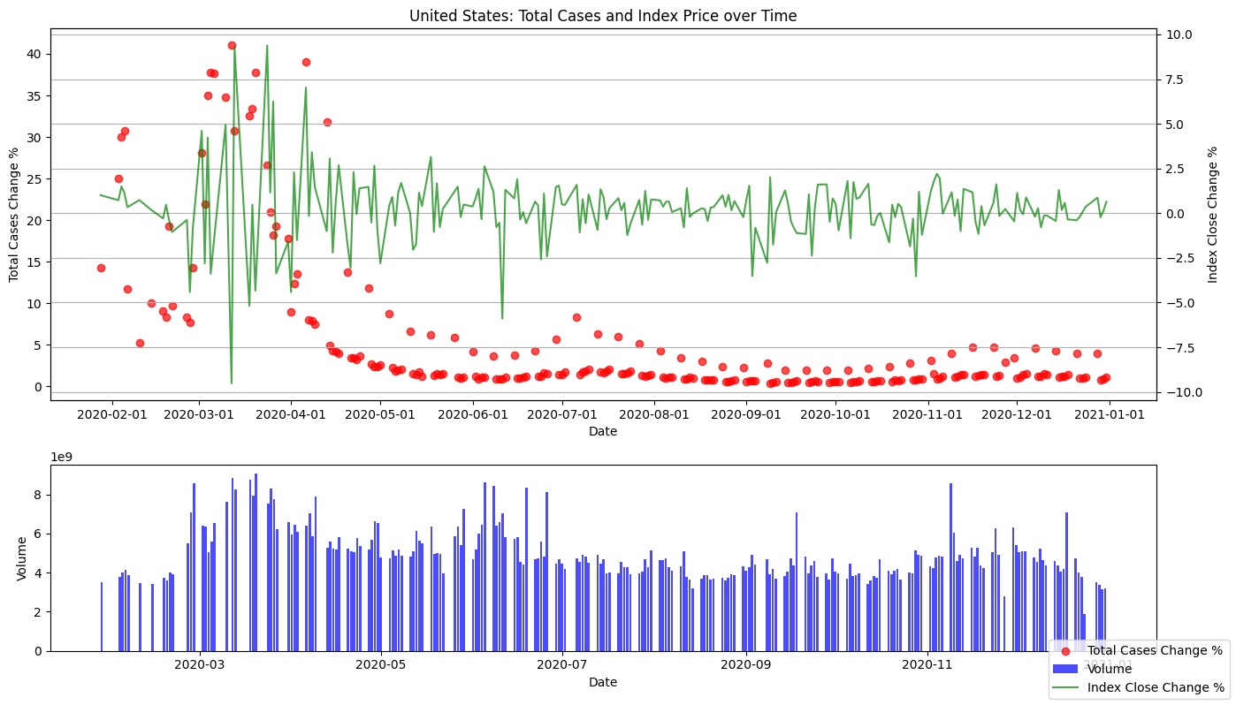
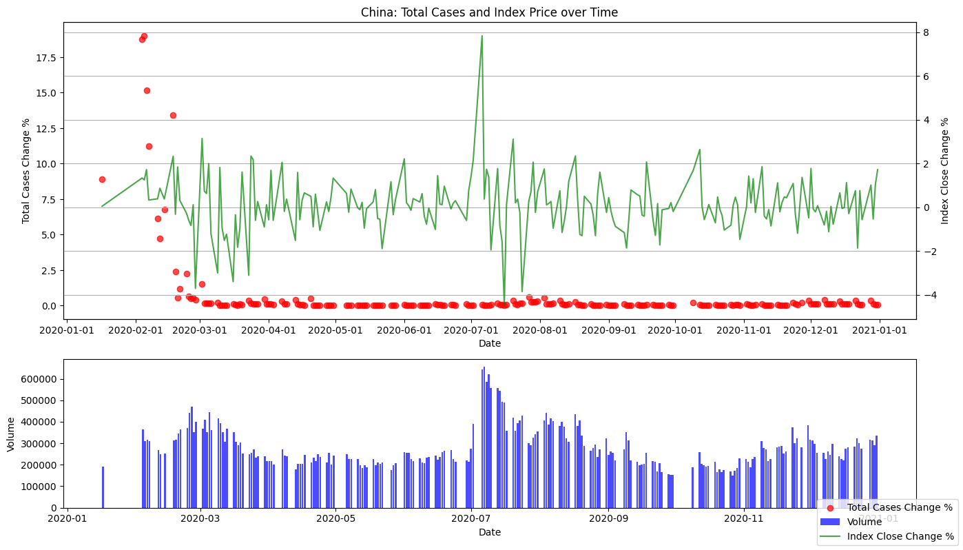
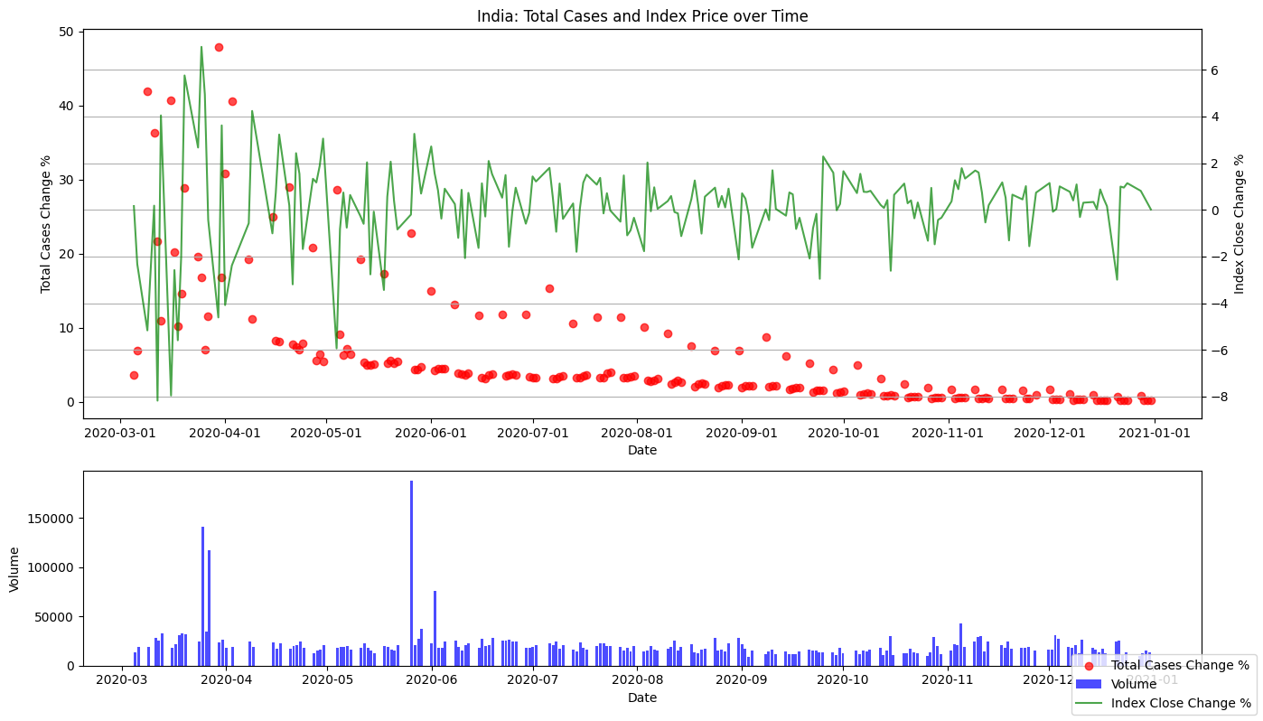
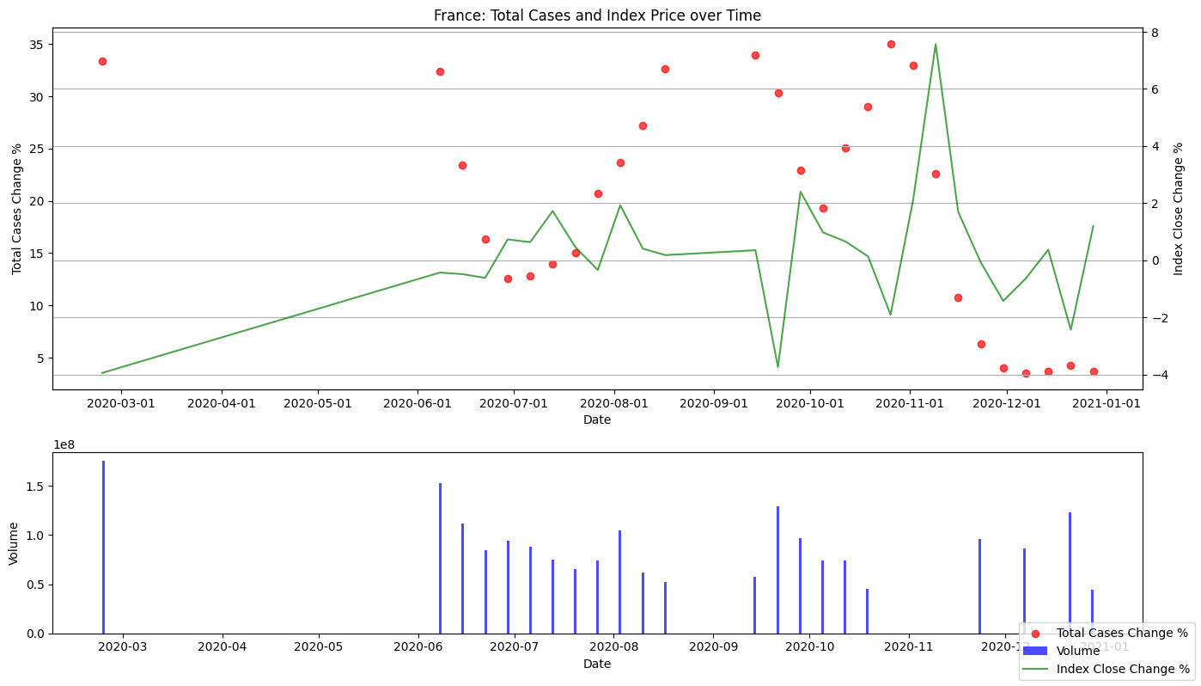
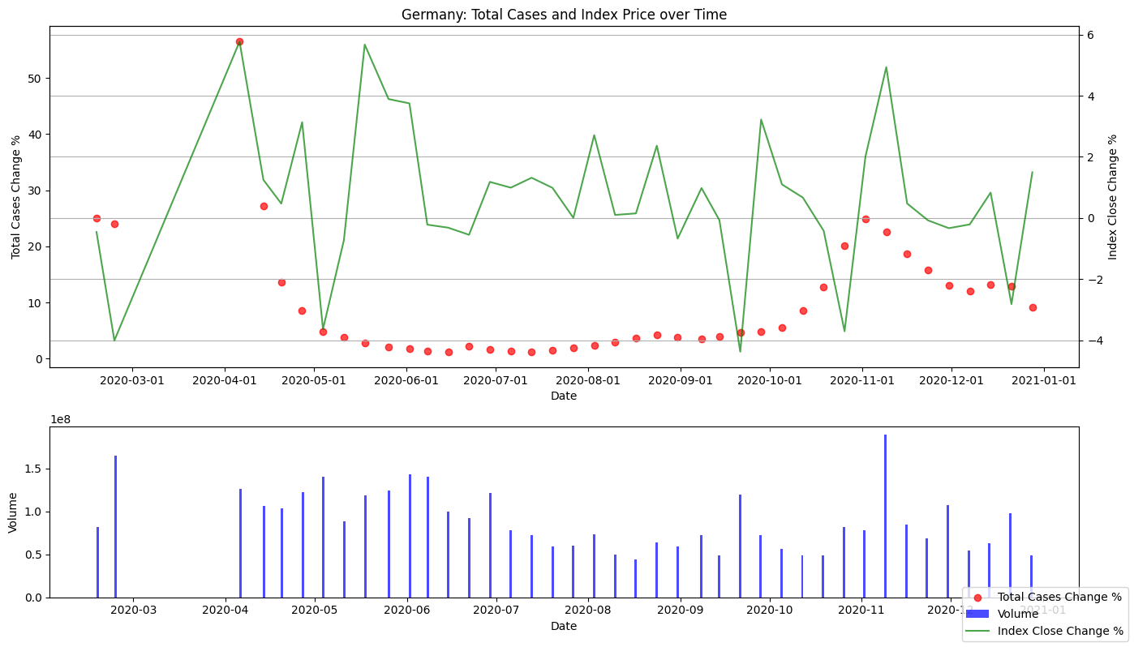
Notes:
United States Correlation of Change in Total Cases to Change in Index Close = 0.06158722587614096
There is a very weak positive correlation (close to 0) between the daily changes in COVID-19 cases in the United States and the daily changes in stock market index closing values. This suggests that there is little to no linear relationship between these variables in terms of daily fluctuations.
China Correlation of Change in Total Cases to Change in Index Close = 0.15695422637978795
There is a weak positive correlation (around 0.16) between the changes in COVID-19 cases in China and the changes in stock market index closing values. The relationship indicates a slight tendency for changes in COVID-19 cases to be associated with changes in stock market performance, but it is relatively weak.
India Correlation of Change in Total Cases to Change in Index Close = -0.3306403119228861
There is a moderate negative correlation (around -0.33) between the changes in COVID-19 cases in India and the changes in stock market index closing values. This negative correlation suggests that as COVID-19 cases increase, the stock market indices tend to decrease, and vice versa.
France Correlation of Change in Total Cases to Change in Index Close = -0.06270227619251455
There is a very weak negative correlation (close to 0) between the changes in COVID-19 cases in France and the changes in stock market index closing values. Similar to the United States, this indicates little to no linear relationship in terms of daily fluctuations.
Germany Correlation of Change in Total Cases to Change in Index Close = 0.1257568191060979
There is a weak positive correlation (around 0.13) between the changes in COVID-19 cases in Germany and the changes in stock market index closing values. The relationship suggests a slight tendency for changes in COVID-19 cases to be associated with changes in stock market performance, though it is not very strong.

Slide 26
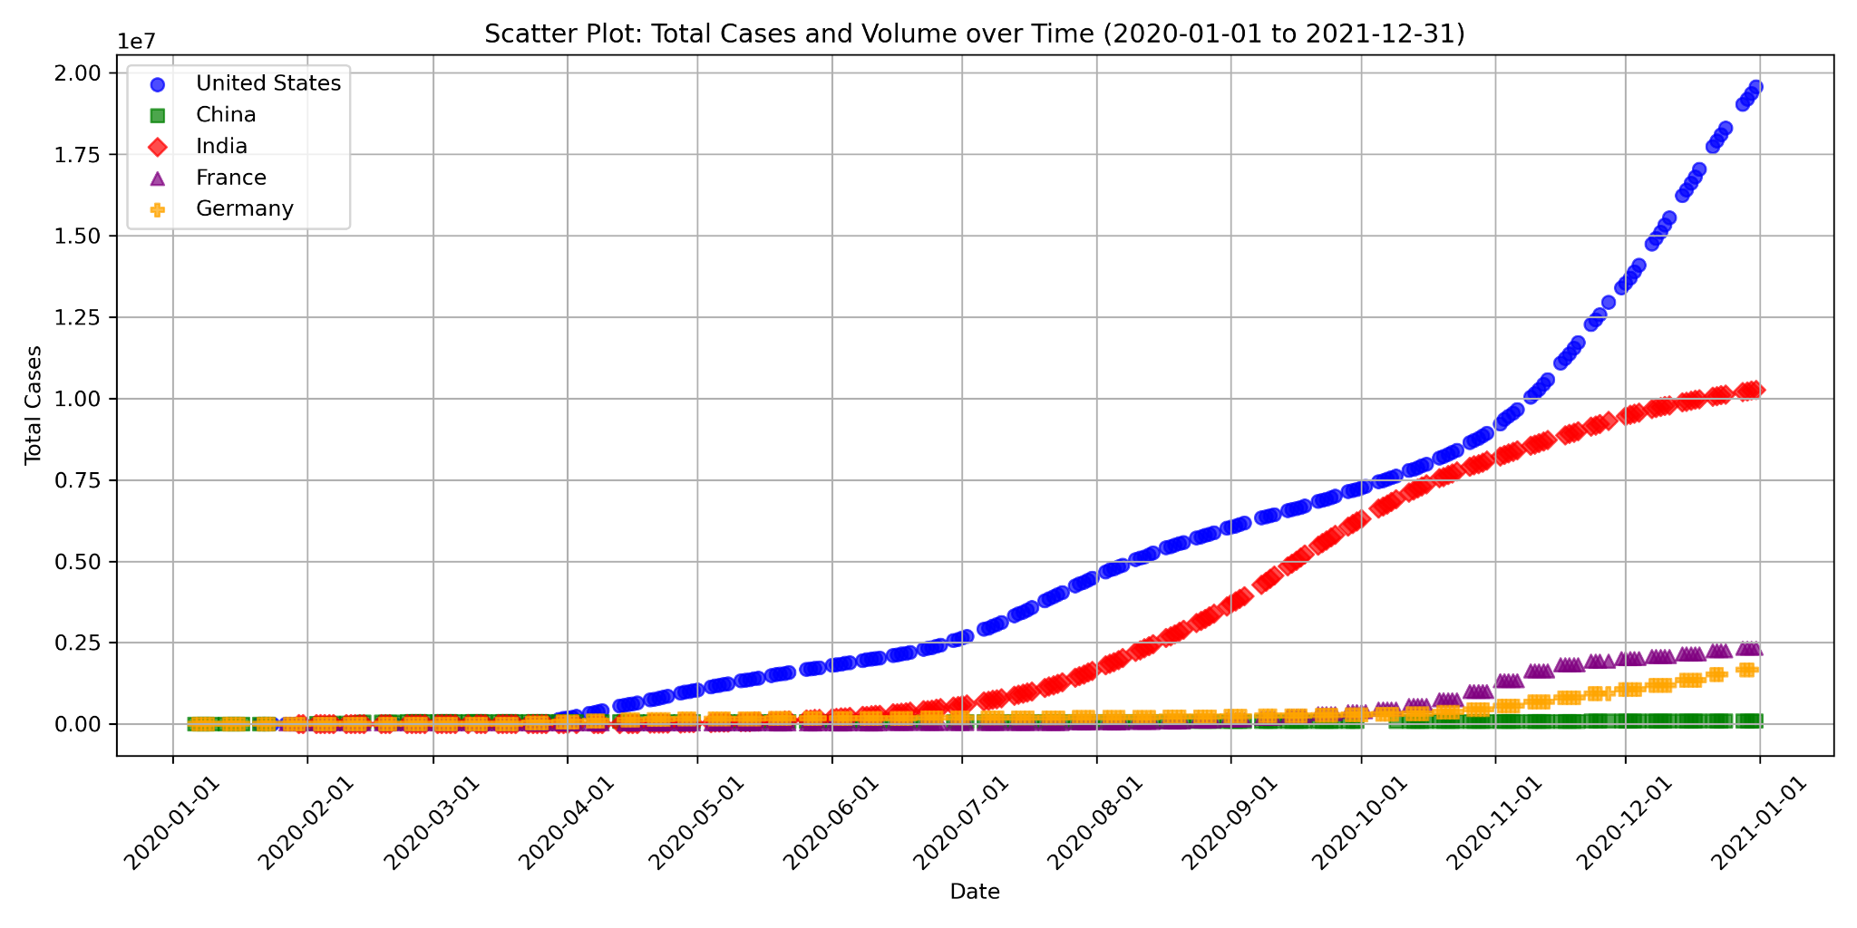

Slide 27
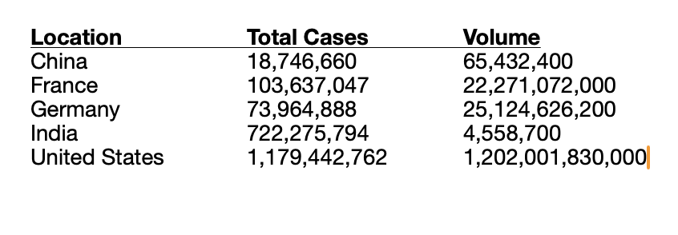
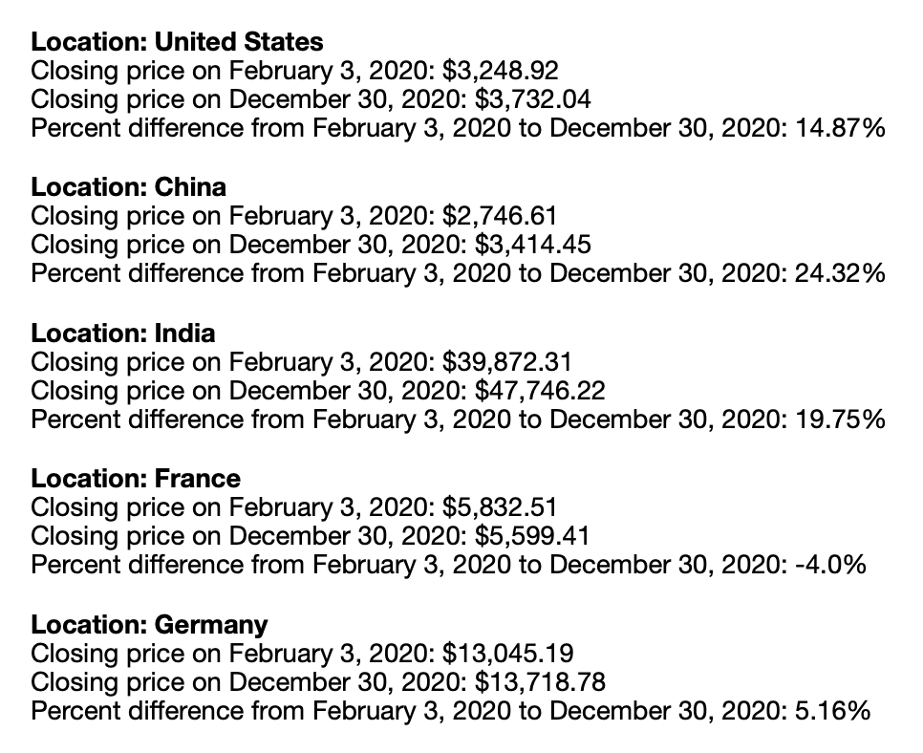
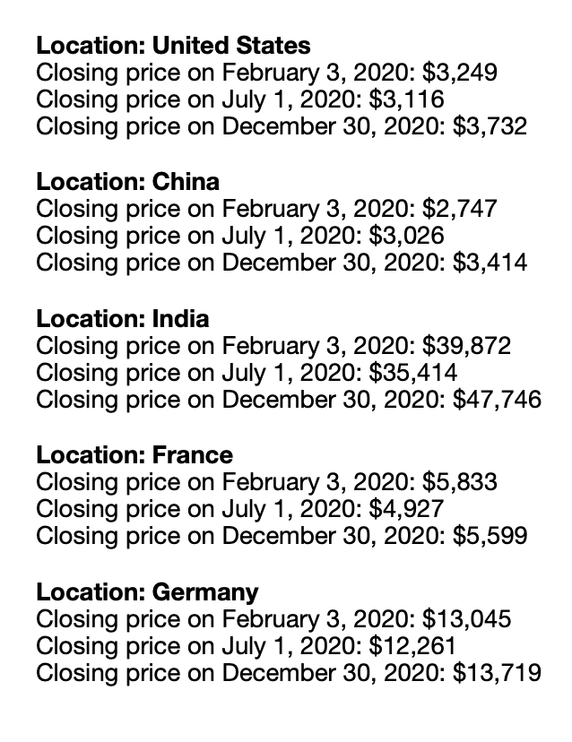

Slide 28
Future Developments

Slide 29
Thank You

